Slide 1
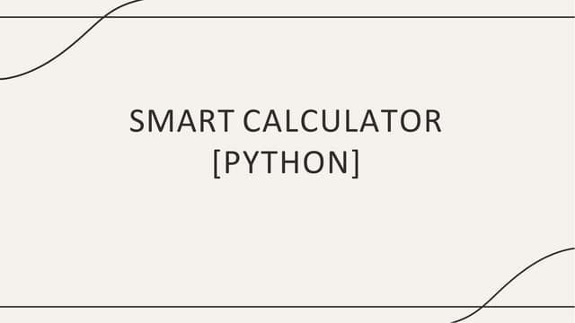
By : Fawwaz Faizal

Slide 2

Table of Content
Introduction
Purpose
Goals
What to expect before Demo
Demo
Conclusion and Source Reference

Slide 3

Introduction
This project processes natural language inputs, stores calculation history, handles errors gracefully, and interacts with users in a conversational manner
Capable of performing both basic and advanced mathematical operations
Serves as an engaging way to practice essential Python programming concepts while simulating a user-friendly AI assistant

Slide 4
Purpose
To develop a practical Python application that enhances problem-solving skills by integrating core programming concepts with basic AI techniques
Preparing learners for more advanced AI and software development tasks

Slide 5
Goal
- Performs basic and advanced mathematical operations (addition, exponentiation, percentages, etc.).
- Parses natural language inputs (e.g., "What is 10 minus 3?") using string manipulation.
- Stores and retrieves past calculations for user reference.
- Handles errors (e.g., invalid inputs, division by zero) without crashing.
- Simulates a chatbot with simple dialogue responses (e.g., greetings, suggestions).
- Encourages best practices in Python programming, including functions, loops, and data structures like lists/dictionaries.

Slide 6
What to expect in this Project for Demo?
Focuses on simple AI things
Functions, Expressions, Operations and many more
Supports Languages (like Malay Language)
Uses Regular Expression and Maths
Test Cases

Slide 7



Slide 8
Conclusion
By combining AI-based text parsing with Python programming to create a functional and user-friendly bilingual calculator
For future improvements, such as expanding NLP capabilities, adding a graphical interface, or integrating voice input

Slide 9
Source Reference
https://www.geeksforgeeks.org/python/smart-calculator-in-python/ - Smart calculator in Python - GeeksforGeeks
https://www.mindstick.com/articles/335762/building-an-ai-calculator-using-nlp-and-python - Building an AI Calculator Using NLP and Python – MindStick
https://github.com/PradipDhokare/smart-calculator - GitHub - PradipDhokare/smart-calculator: Smart Calculator using Python
https://www.youtube.com/watch?v=s7YQU1elfhs - Master Python with This Advanced Calculator! 💡 Functions, Security & Smart Logic Explained

Slide 10


